Slide 1
Group Categorization and Ticket Resolution Time Prediction through Machine Learning
Ashish Sarkar
(2019hc04098@wilp.bits-pilani.ac.in)

Slide 2
Team Construct

Slide 3

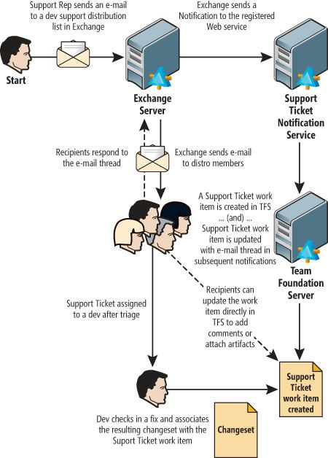
Team Construct | Dissertation Topic & Team Details
Dissertation Topic : Group Categorization and Ticket Resolution Time Prediction through Machine Learning
Name of Student : Ashish Sarkar
E-mail ID of Student : 2019hc04098@wilp.bits-pilani.ac.in
Name of Supervisor : Sandip Das
E-mail ID of Supervisor : Das.Sandip@cognizant.com
Name of Evaluator :
E-mail of Evaluator :
Supervisor
Evaluator
Ticket Classification and predicting resolution time
Student

Slide 4
Abstract

Slide 5
Abstract | Problem Details & Business Objective
Problem: When an issue or support ticket drops into the IT helpdesk- L0, first it needs to be processed and assigned right severity. These tickets are then routed to the right group for resolution, according to the department that would be a perfect fit for the label of that ticket. Hence, the ticket needs to be correctly labeled and severity needs to be defined properly, so that there is no waste of time and resources in routing the ticket to the right agent, only adding to the resolution time of that ticket. In the currently scenario this process is manual, and we are seeing lot of efforts and time are being required to do so. Incorrect assignment of IT service desk tickets leads to reassignment of tickets, unnecessary resource utilization and delays the resolution time. Other than this, we have seen the accuracy level for correctly tagging the ticket is approximately 50 to 55% which results in lot of time being wasted to channel the ticket to right group, delaying the overall time to resolve the ticket leading to customer dissatisfaction.
High Quality customer satisfaction is the utmost important when service ticket resolution time performance is considered. L0 team understand the ticket and assign the ticket to respective team. The customer who has issued the ticket is not aware of the actual time taken to resolve the ticket. This leads to increase customer dissatisfaction.
•

Slide 6
Abstract | Problem Details & Business Objective
Automatically classify support tickets: - Automatically classify the IT service desk tickets can done through traditional machine learning models. By mining the historical unstructured ticket description and the corresponding label Ticket classifier models can be trained. The trained model can be used to classify the ticket into respective assigned group along with categorizing urgency, impact, category etc. The model training can be successfully done with previous huge amount of SNOW data. There is some advantage on this
Faster Resolution time
Improved Productivity
More customer satisfaction
Business growth
The real-world service desk ticket data from a large enterprise IT infrastructure is used for our research purpose.
BENEFITS OF Business:
Accurately classify right support group
Save time and money
Real-time Analysis
Consistent Criteria
Performance Improvement
•

Slide 7
Abstract | Problem Details & Business Objective
Automatically predictive support tickets resolution time :
A predictive model has been proposed which will estimate/real time SLA the time to complete a ticket by leveraging the hidden structure of previous historical SNOW records and the use of machine learning algorithms. After models are trained with customer data, they are applied to new tickets at the time of creation. Thus, users who raise the ticket can make use of an estimated time-to-completion in early stages of the customer interaction and can inform customer/user.
Real time analysis of the models: - A real time analysis of the predictive and classification model by deploying the model and understands the overall time taken to do this and improvise thus.
1.4 BENEFITS OF Business :
Real time SLA Prediction – more accurate information can be given to the user
High Performance
Achieve more customer satisfaction
Saving huge amount of cost and time
•

Slide 8
Methodology

Slide 9

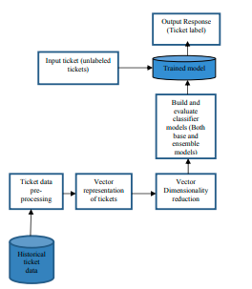
Process | Solution Approach – Classification

Slide 10
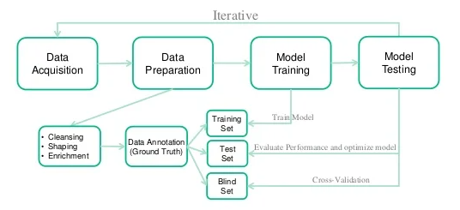
Process | Solution Approach – Prediction
The first step is to clean up all the data by eliminating outliers and treating missing data
Determine whether non-parametric or parametric predictive modeling is more effective
Reprocess the data into an appropriate format for modeling algorithm
Feature engineering and feature selection
Specify a subset of the data which is to be used for training of the model
Train the model parameters to form the trained dataset
Conduct tests to assess model efficacy
Validate the accuracy of predictive modeling on the data which is not calibrated
Send the model for prediction

Slide 11
Uniqueness
While ticket classification has already been done earlier in different research fields, this project comprises live real data to classify 180 levels at least. Most of the work earlier has been done with max 10 to 50 labels but complexity of 180 labels and real data has been the most challenging part to get higher accuracy level.
Prediction of real time ticket resolution time based on the past data has never been done earlier. With so much of data and variation on the data, information it has always been challenge in the industry to predict the approximate resolution time other than the SLA mentioned for each ticket based on priority. Due to high complexity of the ticket data, there hasn’t been too much of work done in this area. Whatever work has been done so far is on the classification of the ticket into certain group by not on predicting the real time solution of the same. Every company has some challenges, and the real time ticket resolution has been based on the business knowledge of the SNOW experts, L0. L1 and L2 specific to this organization.

Slide 12
Final Update 1. Data Collection
2. Exploratory Data Analysis
3. Feature extraction 4. Model Fitting
5. Performance Improvement distributed ML for both
Ticket group classification and resolution time prediction

Slide 13
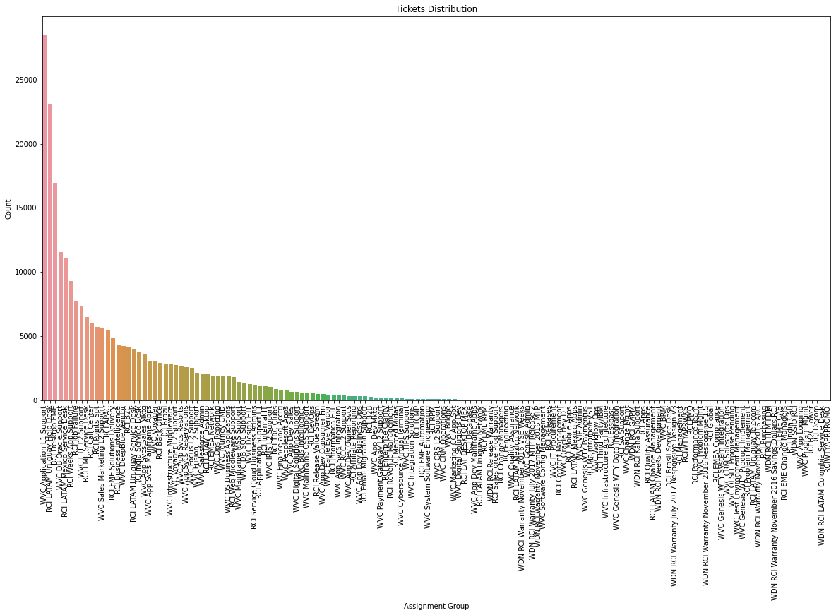
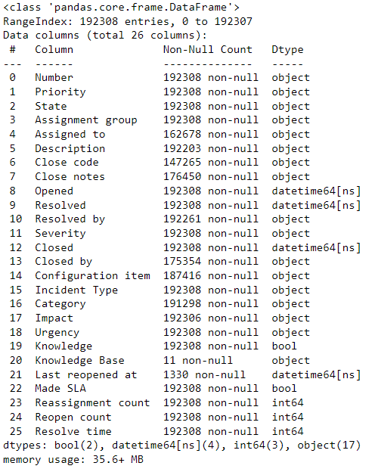
EDA
Meta data and data information
Assignment group has imbalance data set

Slide 14
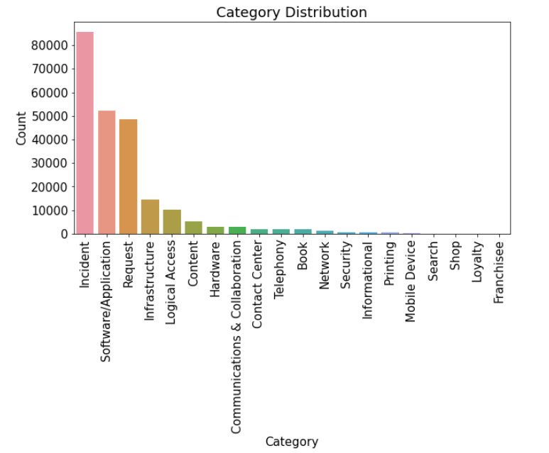
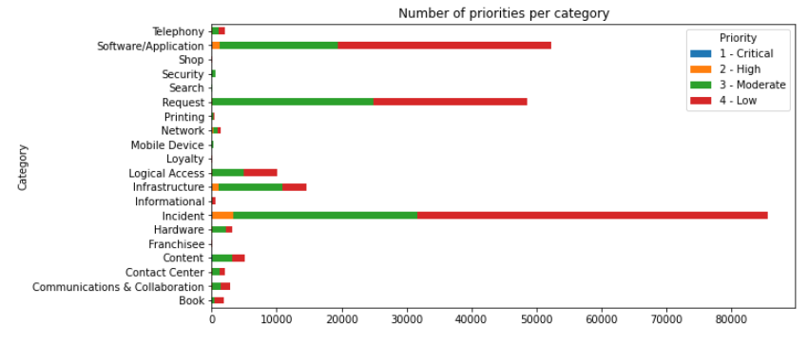
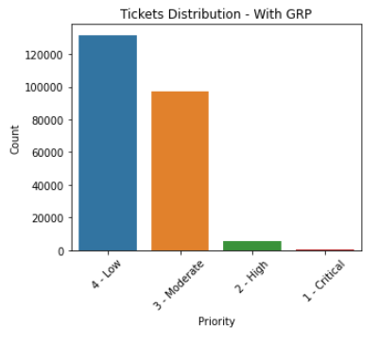
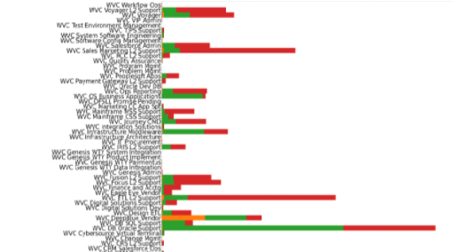
EDA Continued…
Category wise distribution of priority tickets
Normal incident to have the highest count
Assigned group wise ticket prioritization
Low priority has the highest count indicating system stabilization

Slide 15
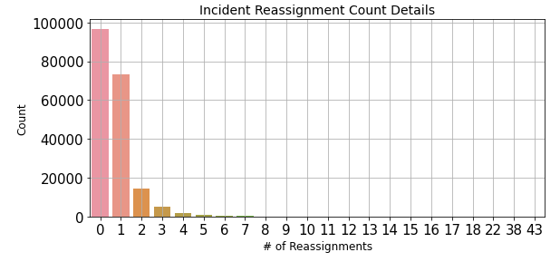
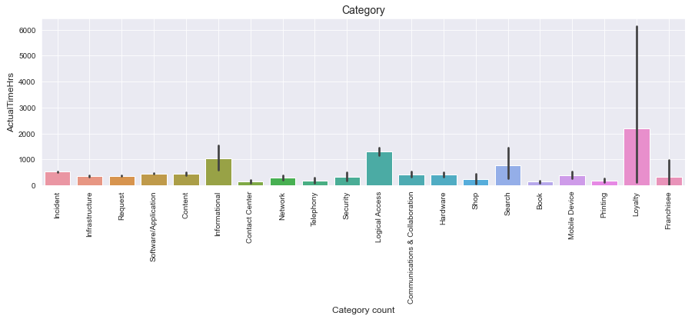
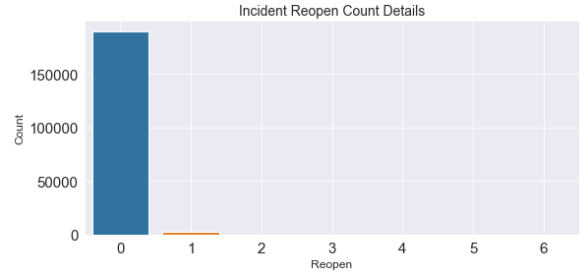
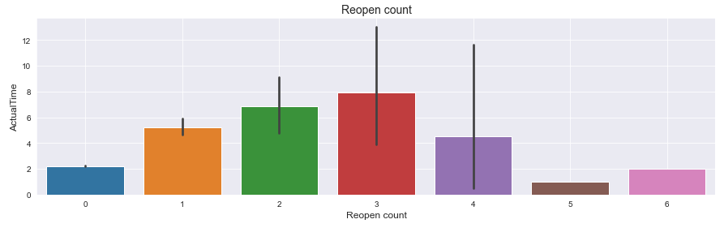
EDA Continued…
Category vs Actual Time
Re-Assignment Count
Re-Open Count
Re-Open Count Vs Actual Time

Slide 16
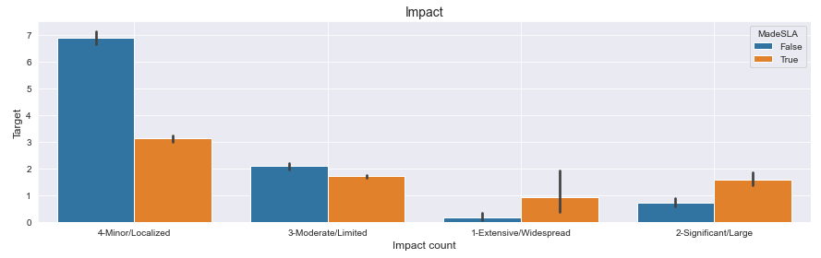
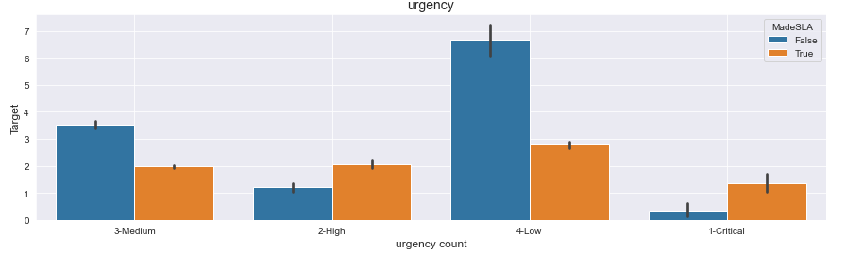
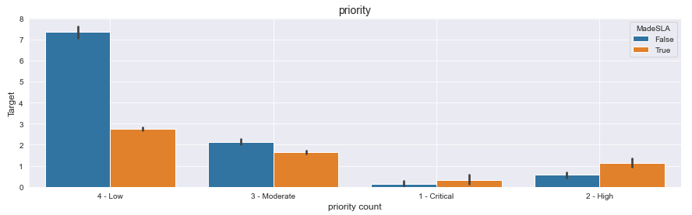
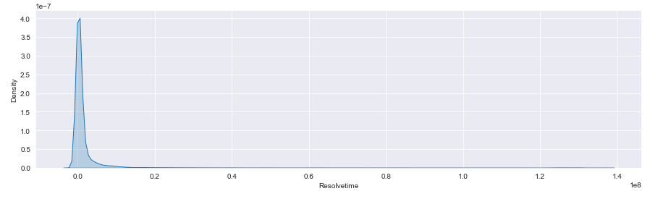
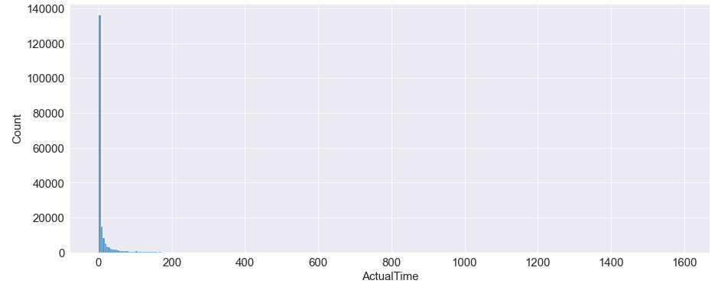
EDA Continued…
Impact Details vs Actual Time
Urgency vs Actual Time
Priority vs Actual Time
Distribution of Actual Time

Slide 17
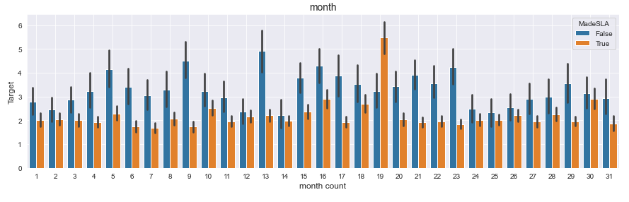
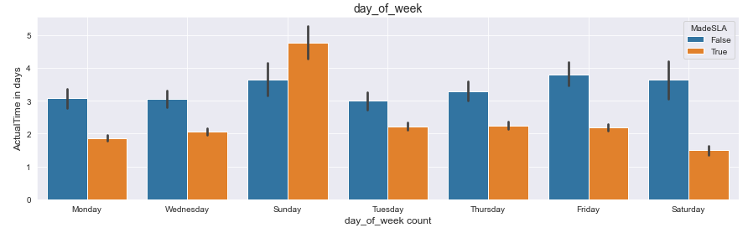
EDA Continued…
Month vs Actual Time
Day of Week vs Actual Time

Slide 18
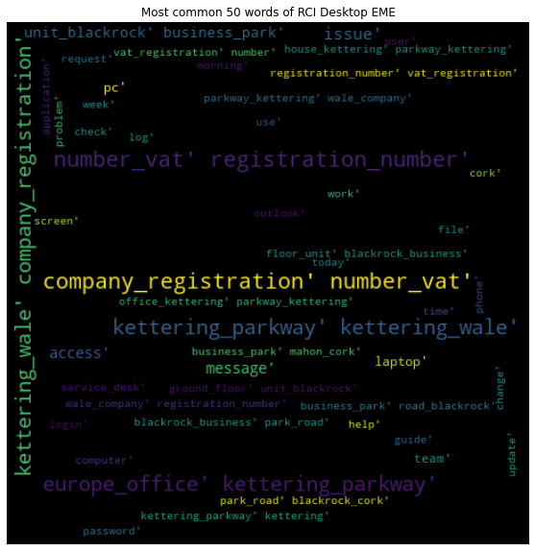
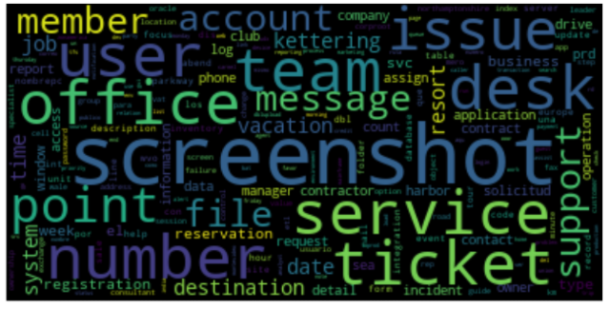
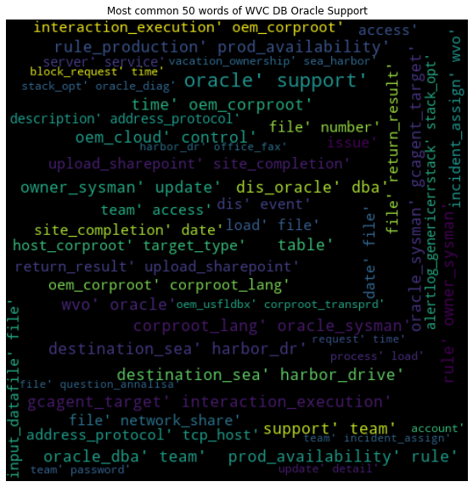
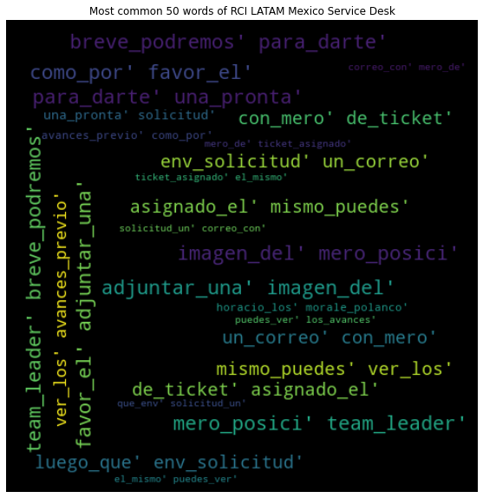
EDA Continued…
Word Cloud of most common words
Word cloud of Common words for RCIDesktop EME
Word Cloud of DBOracle Support group
Word Cloud of RCILatam Mexico Service Desk

Slide 19
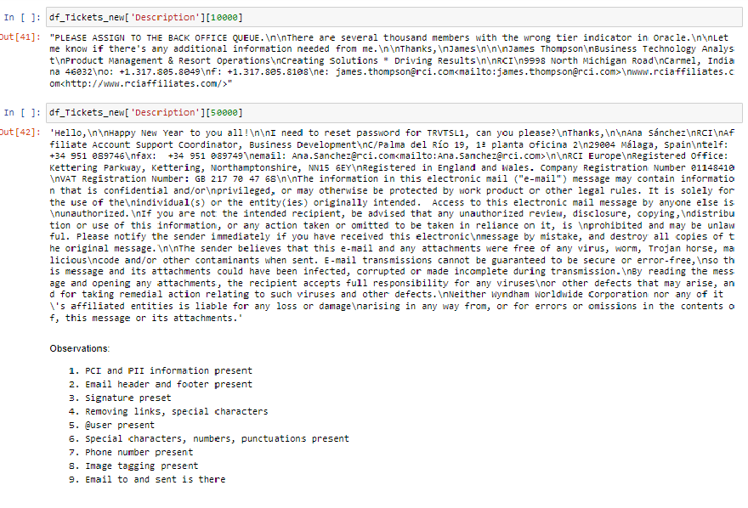
Data wrangling
Data wrangling is the process of cleaning, structuring and enriching raw data into a desired format for better decision making in less time
Understanding column of interest :

Slide 20

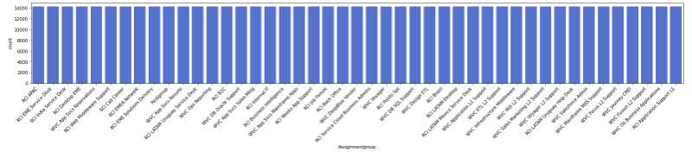
Data wrangling and Models : Continued…
Data Cleaning
Count-Vectorizer
Removing stop words
TD-IDF
Lemmatization
Oversampling using sklearn resample library
Remove Unwanted Email Content
Tokenization
Word Embedding
POS Tagging Nouns
Oversampling
Remove Hapex
Models used so far
Multinomial Naïve Bayes
Logistic Regression
SGD Classifier - SVM
XG Boost Classifier
Light GBM Classifier
Classification Model building
Model Comparison
Model Evaluation
Models

Slide 21
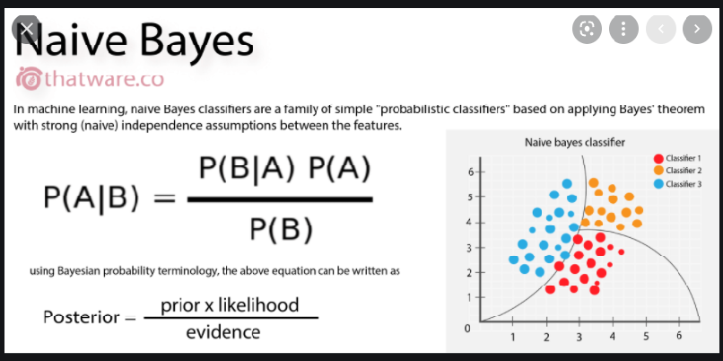
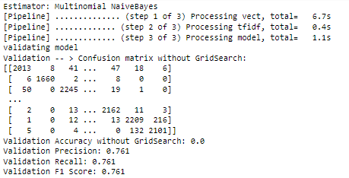
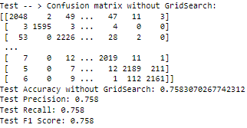
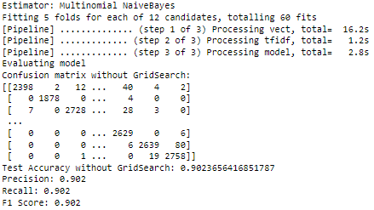
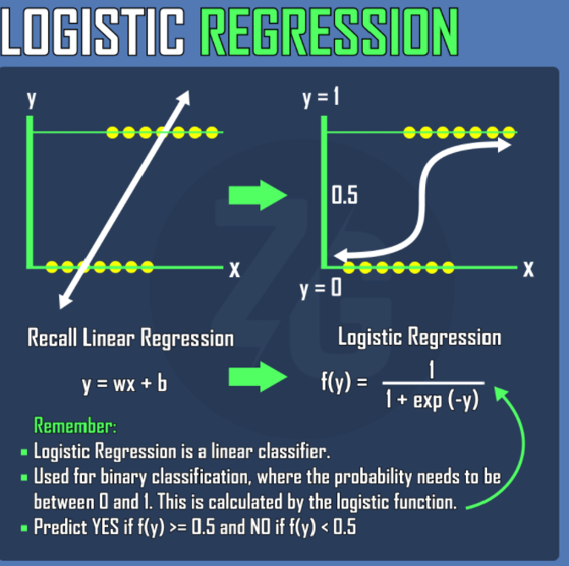
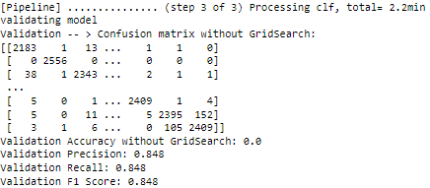
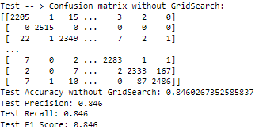
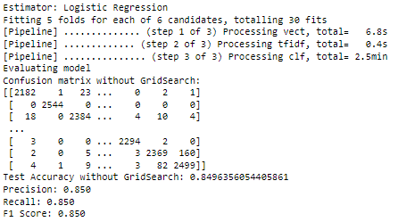
ML Models and Scores:
Without hyperparameter tuning; 1.3 min
Hyperparameter tuning: 1.45 min
Without hyperparameter tuning: 2.2 min
Hyperparameter tuning: 3.4 min

Slide 22
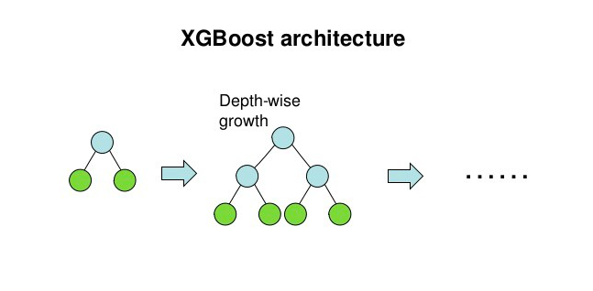
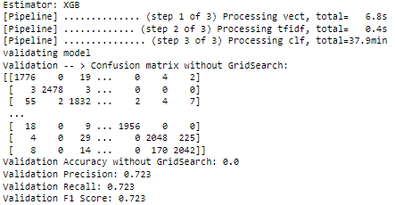
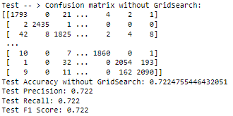
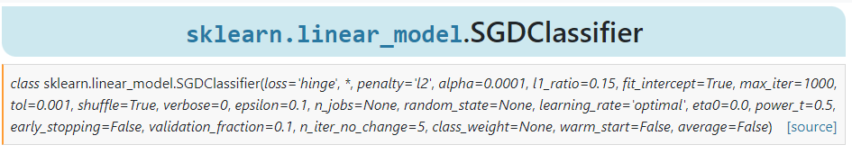
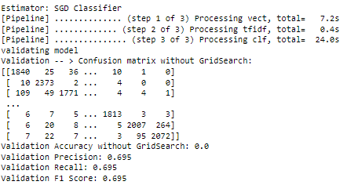
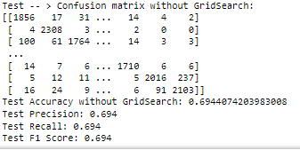
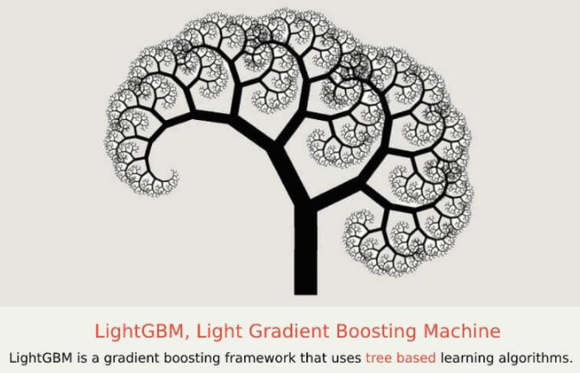
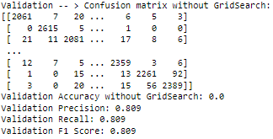
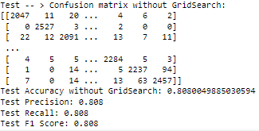
ML Models and Scores: Continued
Without hyperparameter tuning: 38 min
Without hyperparameter tuning: 12 min
SVM Without hyperparameter tuning: 14 min approx.

Slide 23
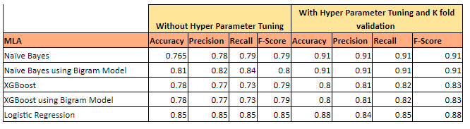
Classification Model Final Score

Slide 24
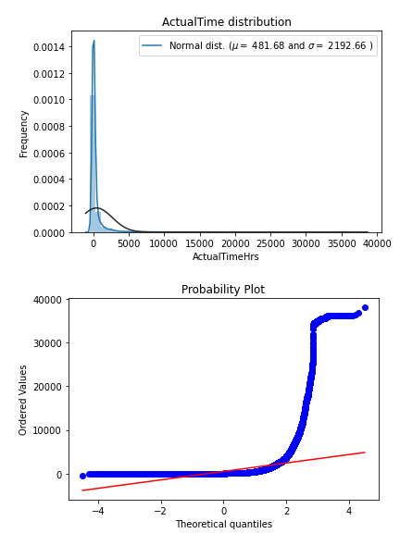
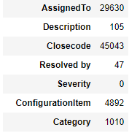
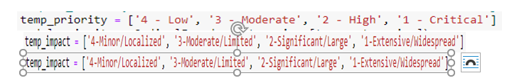
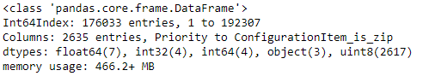
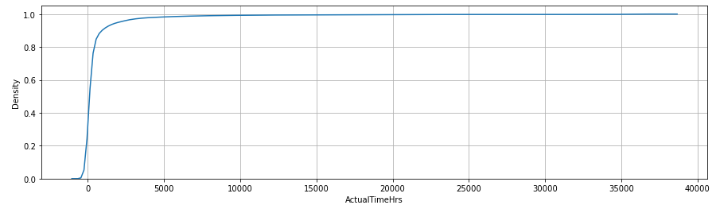
Prediction Model – Data Preprocessing
Removing outlier
Null value check and Imputation
Encoding Categorical values
We have used ordinal encoding for priority , urgency and impact . For assignment group , configuration item , category and hour has been one hot encoded.

Slide 25
Feature addition/generation
Start date/time of the ticket
Instead of taking the date/time we have filter out the date into day of the week, month and date of the month. In EDA we have seen Sunday – day of the week has very important impact on the resolution time. Similarly, month from September to March has higher trend of SLA breaching. Day of the month has also revealed some correlation to the target variable.
Dow
To identify whether ticket has been opened on Sunday or not Sunday. This has improved the performance of the model.
Moy
To identify whether the ticket has been created from September to March or not. This period is mostly festive period and have positive correlation with target variable
Tow
Time of ticket which has direct correlation with target variable. Time of creation can be a critical variable for service organizations that work with a non-continuous schedule. For example, extra minutes can be added if a ticket is created during lunch time, or if a ticket is created in a Friday afternoon and has to wait until the next Monday to be processed.

Slide 26
Feature addition/generation
Performance of the resolved by
Some service agents are more experienced than others in assigning tickets to the right teams. It helps reduce the ticket transition time between teams. We have created a mean average effort continuous variable for each on the associates who has been part of ticket resolution. we have checked both mean, and mode of the variable and seems same.
Assignment To Resolved By Finally
We have also reviewed how assignment to → Resolved BY variable can be correlated to target variable. So if assigned to and resolved by is same then we have seen resolved time is more quick than if different person is assigned to resolve the issue.

Slide 27
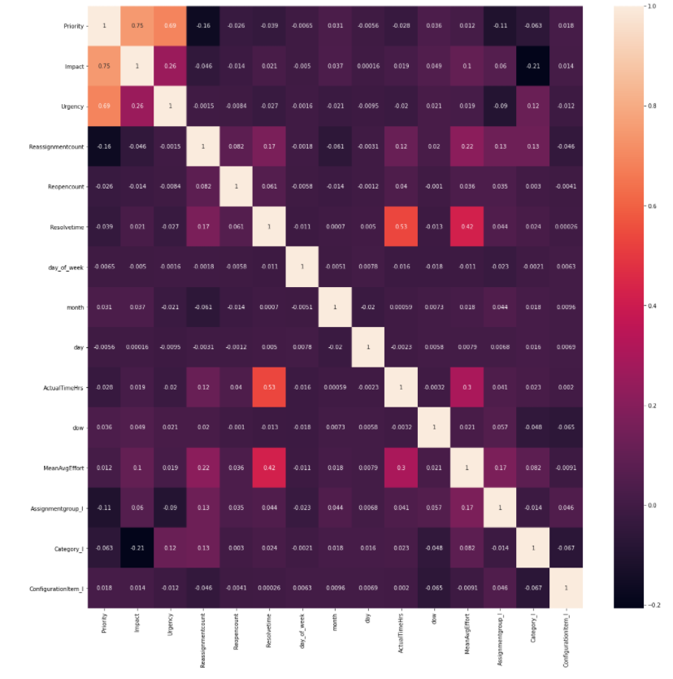
Feature Selection – Heat Map

Slide 28


Feature Selection –
Annova Analysis
Feature selection using Extra Tree Classifier

Slide 29

Model Performance of Regression Model
Metrics to be followed
MAE: Mean Absolute Error
Root Mean Squared Error (RMSE)
R Squared

Slide 30





Model Performance of Regression Model
We have chosen Random Forest Regressor to be the best performer
Random Forest Regressor Statistics
Graphical Representation

Slide 31



Distributed ML: Spark MLib
When used on a single machine, Spark can be used as a substitute to the default multithreading framework used by scikit-learn.
If a need comes to spread the work across multiple machines, no change is required in the code between the single-machine case and the cluster case.
We explored how to integrate Spark with scikit-learn, and the result is the Scikit-learn integration package for Spark. It combines the strengths of Spark and scikit-learn with no changes to users’ code. It re-implements some components of scikit-learn that benefit the most from distributed computing. Users will find a Spark-based cross-validator class that is fully compatible with scikit-learn’s cross-validation tools. By swapping out a single class import, users can distribute cross-validation for their existing scikit-learn workflows.
Grid Search CV using Spark ML Lib on Spark Cluster
SkLearn vs Spark ML

Slide 32




Distributed ML: Spark ML
Feature Extraction
Cleaned and oversampled description in tokenized
Tokenized Data is count vectorized and TD-IDF + n-gram
Output is fed to vector assembler
Partitioned into train and test
Used Spark ML Logistic Regression for training and Test
Spark ML with Logistic Regression
Spark ML with Multinomial Naïve Bayes Regression
Completed Jobs in Spark Cluster

Slide 33
THANK YOU

